Slide 1

Case Study 2.0 ConocoPhillips
Team 1
Andreja Duric, Maximilian Kuttner, Robin Köfer, Matteo Lerda, Santiago Orantes, Dominic Wisak

Slide 2
Outline
Introduction
Rolling Equity Betas
Debt Rating
Asset Beta

Slide 3


ISIN: US20525C1045
Industry: Petroleum Industry (Downstream Business)
Founded: 30 August 2002
Headquarters: Houston Texas
Products: Petroleum, Natural gas, Natural gas liquides, Bitumen
Revenue: US$ 36.670 billion (2019)
Net income: US$ 7.189 billion (2019)
Total assets: US$ 70.514 billion (2019)
Total equity: US$ 35.050 billion (2019)
Number of employees: 10,400 (2019)
Side facts:
Ranked as the 14th most polluting company in the world by The Guardian in 2019.
After the acquisition of Concho Resources for $9.7 bln it became the third largest energy company currently operating in the oil-rich North America.

Slide 4
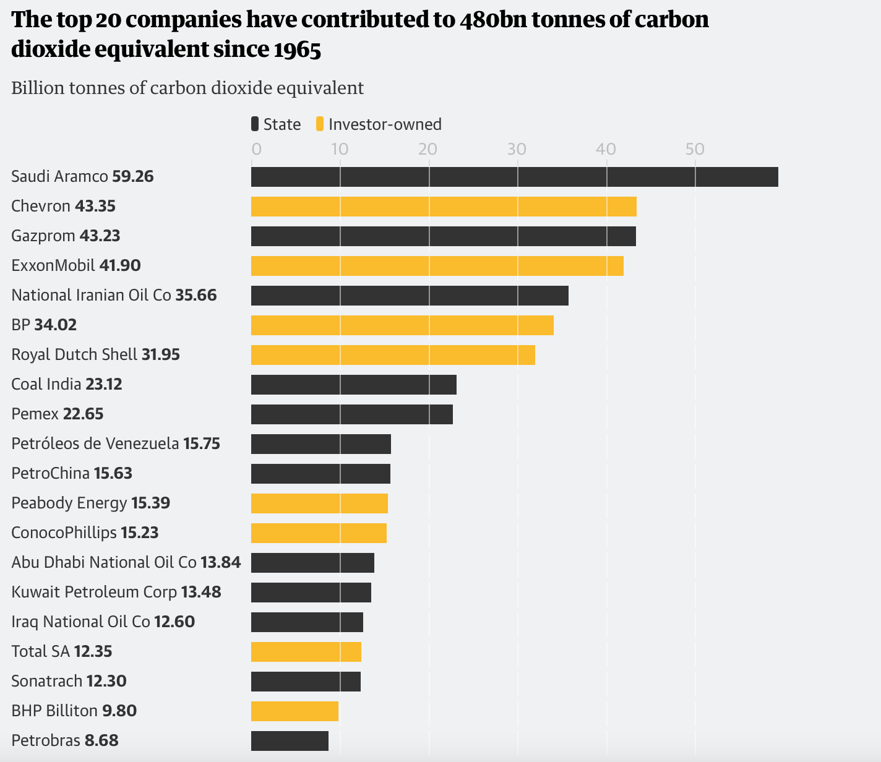
Source: the Guardian (2019)

Slide 5

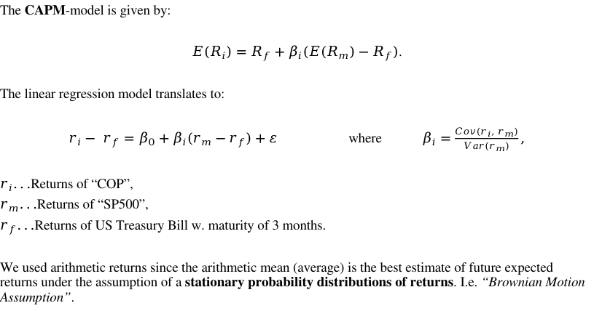
Equity Beta
The CAPM-model is given by:
$E(R_{i})=R_{f}+β_{i}({E(R}_{m})−R_{f})$.
The linear regression model translates to:
$r_{i}− r_{f}=β_{0}+β_{i}(r_{m}−r_{f})+ε$ where $β_{i}=\frac{Cov(r_{i}, r_{m})}{Var(r_{m})},$
$r_{i}...$Returns of “COP”,
$r_{m}...$Returns of “SP500”,
$$r_{f}...$$Returns of US Treasury Bill w. maturity of 3 months.
We used arithmetic returns since the arithmetic mean (average) is the best estimate of future expected returns under the assumption of a stationary probability distributions of returns. I.e. “Brownian Motion Assumption”.

Slide 6
Rolling Equity Beta - daily

Slide 7
Rolling Equity Beta - weekly

Slide 8
Rolling Equity Beta - monthly

Slide 9

Debt Ratings
Fitch Ratings
Date | Rating | Action | FIX
2021-01 | A | Affirmed | 5
2020-10 | A | Affirmed | 5
2019-11 | A | Affirmed | 5
2019-04 | A | Review | 5
2018-08 | A | Upgrade | 5
2018-01 | A- | Affirmed | 4
2017-10 | A- | Review | 4
2017-02 | A- | Affirmed | 4
2016-09 | A- | Review | 4
2016-03 | A- | Downgrade | 4
2015-09 | A | Review | 5
2015-04 | A | Affirmed | 5
Moody's
Date | Rating | Action | FIX
2021-10 | A3 | Affirmed | 4
2018-09 | A3 | Upgrade | 4
2018-06 | Baa1 | Affirmed | 3
2018-03 | Baa1 | Affirmed | 3
2017-08 | Baa1 | Upgrade | 3
2017-03 | Baa2 | Affirmed | 2
2016-02 | Baa2 | Downgrade | 2
2015-12 | A2 | Review | 5
2015-08 | A2 | Downgrade | 5
2015-02 | A1 | Affirmed | 6

Slide 10
Debt Ratings

Slide 11
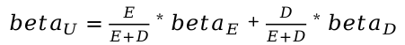
Asset Beta (Unlevered Beta)
$beta_{U}=\frac{E}{E+D}$ * $beta_{E}$+ $\frac{D}{E+D}$ * $beta_{D}$

Slide 12
Asset Beta (Unlevered Beta)

Slide 13
Debt Beta
Until last quarter of 2015 debt rating is A-
Current debt rating is A

